Slide 1
How to receive multiple PO Lines in batch
Yoel Kortick
Senior Librarian

Slide 2

Agenda
Introduction
Performing "Receive all"

Slide 3
Introduction

Slide 4
Introduction
It is possible to receive all items for PO lines filtered on the Receive New Material page.
This saves time instead of receiving one by one
First set the filter to display the desired PO lines and then click "Receive all"
Note that this will receive up to 1,000 PO Lines, therefore including all PO Lines which answer the query of the filter and not only those seen on the page.

Slide 5
Introduction
When doing "Receive all" the parameters from the "Receive New Material" page are also taken into account. These include, for example, "keep in department", "next step", and "receiving date".
This process is not relevant when Shelf Ready is selected.
In order to maximize performance, the "Receive all" is done via a background job viewable in "Monitor Jobs"

Slide 6
Performing "Receive all"

Slide 7
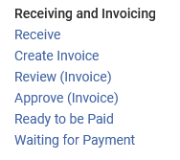
Performing "Receive all"
We will access the "Receive New Material" page via "Acquisitions > Receiving and Invoicing > Receive"

Slide 8
Performing "Receive all"
On the next slide we filter by PO Lines in status "Sent" for owning library "Main Library"
We have 27 POLs and then click "Receive all".
Note that the first example is POL-46711 "Bamboo shoots after the rain : contemporary stories by women writers of Taiwan" .
We will use this as an example and see if it is received along with the 27 results

Slide 9
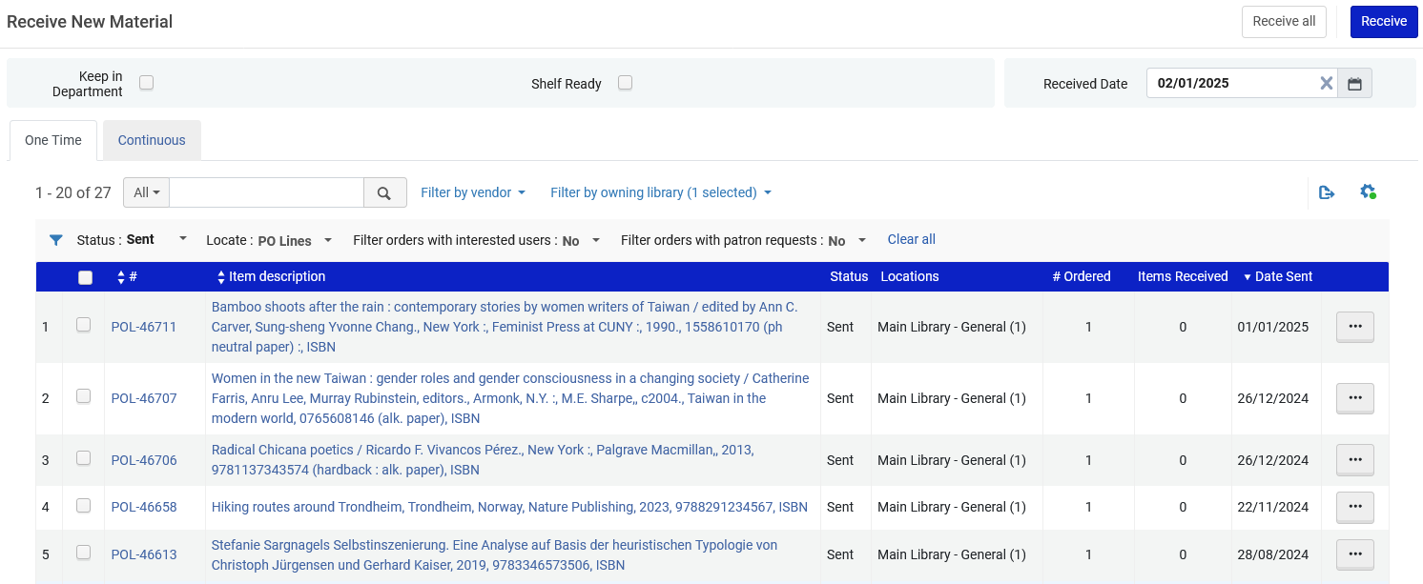
Performing "Receive all"
We will click "Receive all"
27 POLs
Filtered by Status = Sent and Owning Library = Main Library
This is the example we will check later

Slide 10
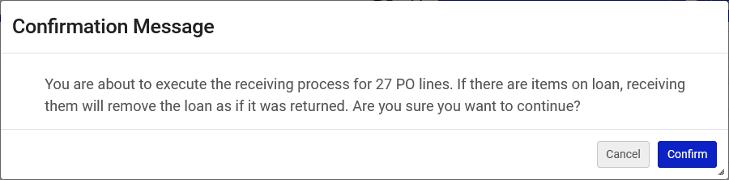
Performing "Receive all"
We will confirm the message

Slide 11
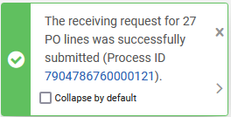
Performing "Receive all"
We receive a message that a background job has been sent to perform the "Receive"

Slide 12
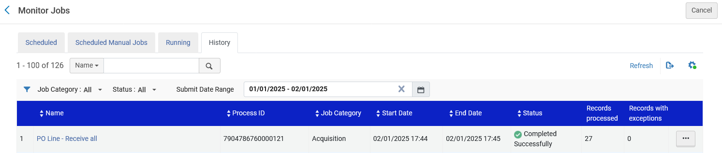
Performing "Receive all"
The background job runs and completes (accessed at "Admin > Manage Jobs and Sets > Monitor Jobs")
Note that the job ran on Jan. 02 at 17:44. We will later see that this as the receiving date of the items being received.

Slide 13
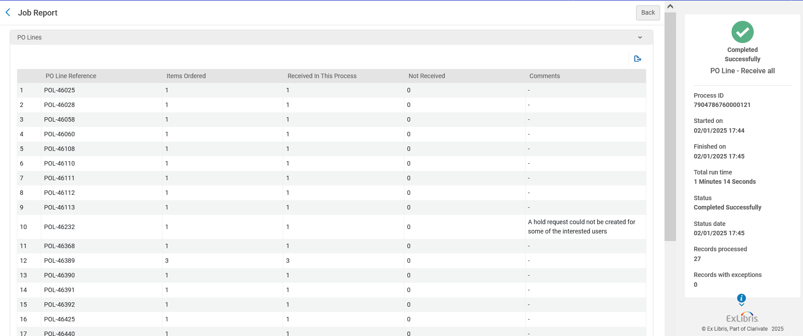
Performing "Receive all"
The job report states how many items were received and what the POLs were

Slide 14
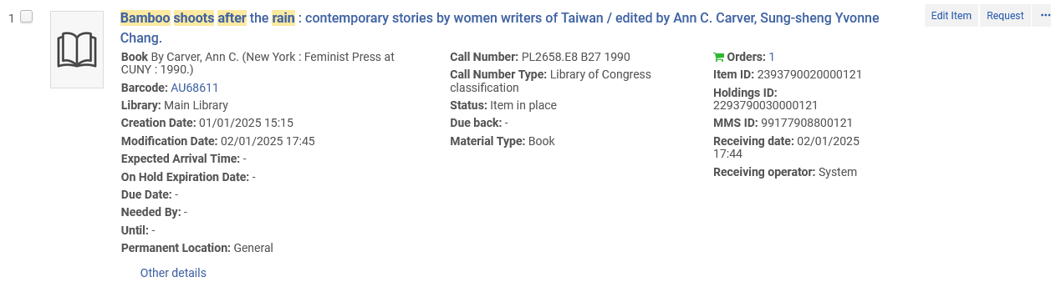
Performing "Receive all"
Now we can check our example POL-46711 "Bamboo shoots after the rain : contemporary stories by women writers of Taiwan".
It was successfully received along with all of the other filtered PO Lines from the "Receive New Material" page.
It was received
Note that the receiving date of the item is the same time the job ran (which we saw previously)

